Slide 1
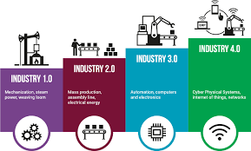
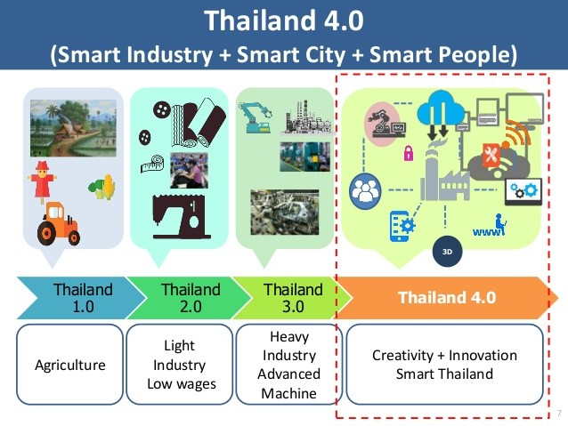

“ทิศทางการพัฒนาฝีมือแรงงานในอนาคต”
วันอังคารที่ 24 ธันวาคม 2562
ณ ห้องประชุมปกรณ์ อังศุสิงห์ กรมพัฒนาฝีมือแรงงาน

Slide 2
HR Main Functions
Industrial Key Qualifications
Recruit
Retain
Retire
Training and Development
Compensations and Benefits
Performance Management System
Career Path

Slide 3

Adaptability
Good
Smart
Work
Force
4.0
Adaptability
Adaptability
Happy

Slide 4

Challenges of TVET???

Slide 5
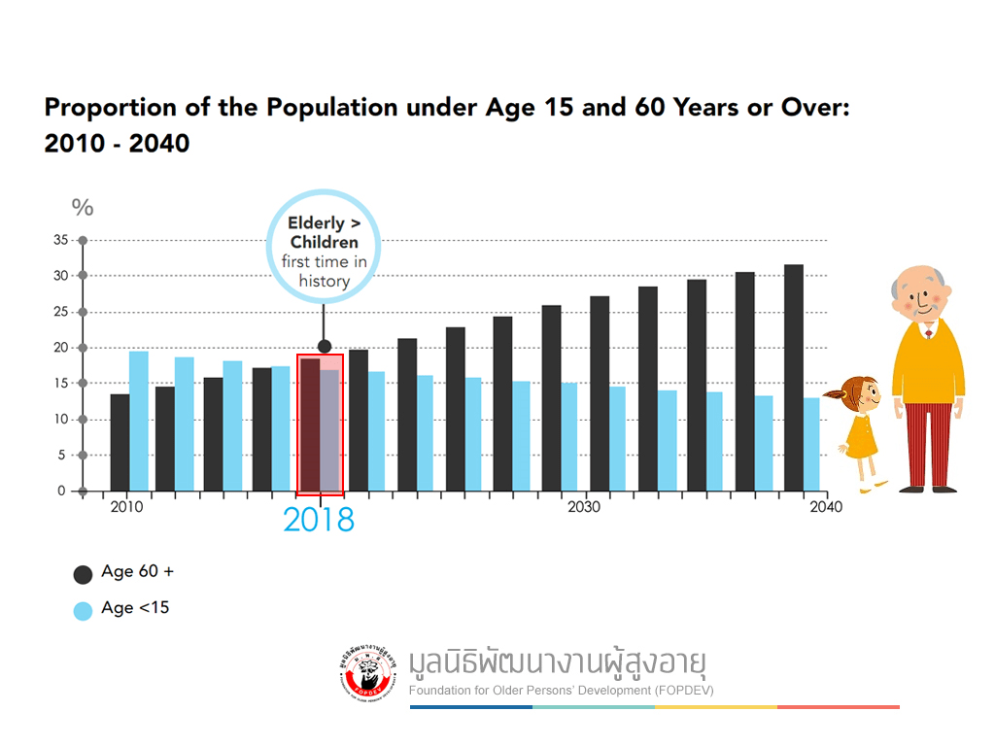

Slide 6
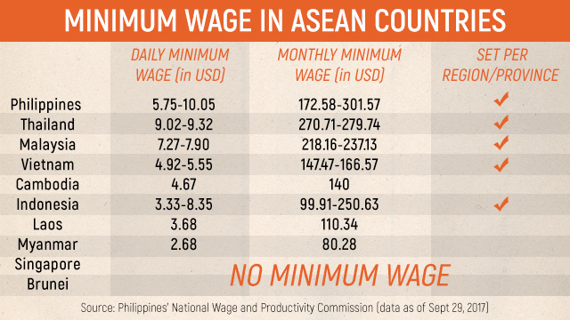

Slide 7
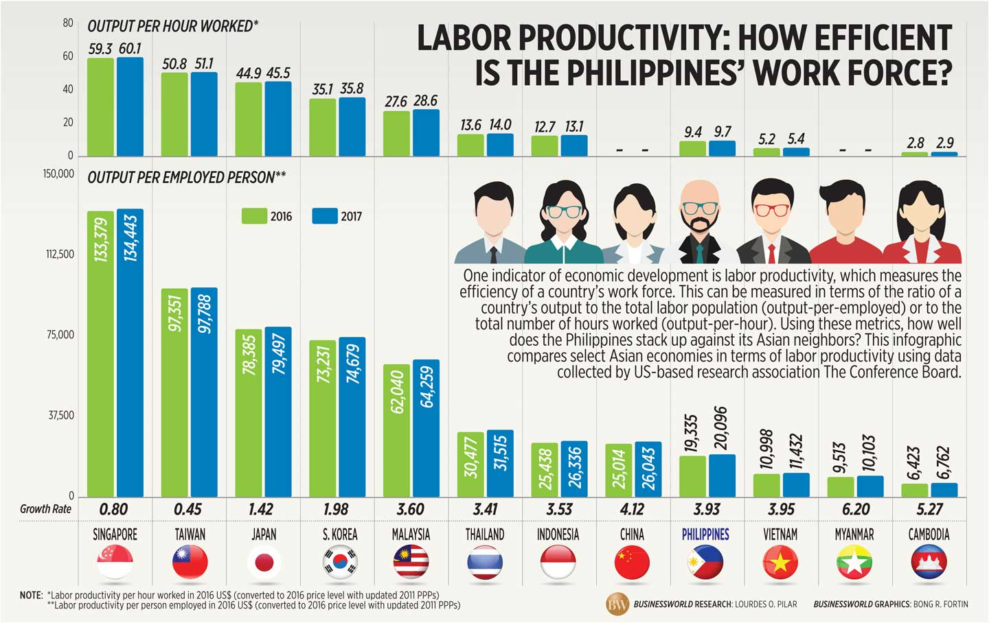

Slide 8
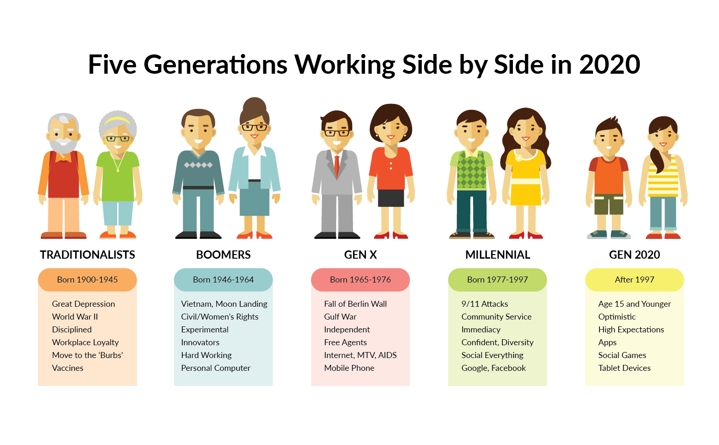

Slide 9

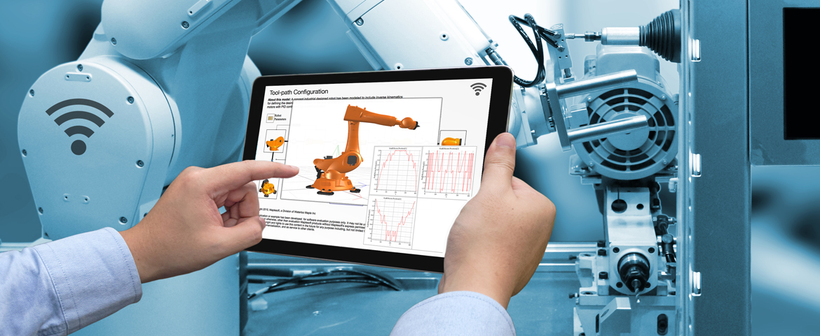
4Ds Industry:
1. Dirty
2. Dangerous
3. Difficult
4. Dignity
Digital Industry

Slide 10

เรื่องที่เกี่ยวกับการเดินทาง ขนส่ง
ความรู้ทักษะอะไรของคนเมื่อ 100 ปีก่อน
ที่คนปัจจุบันไม่จำเป็นต้องมี ????

Slide 11
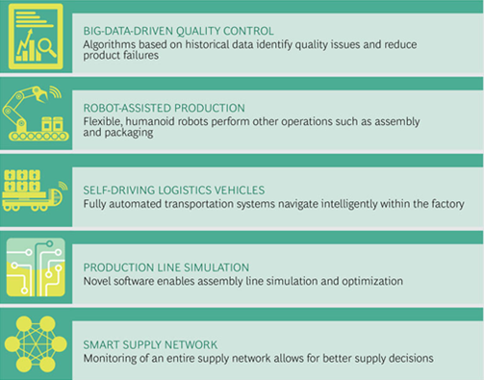
Use cases show the effect of Industrial 4.0 on the workforce
Source: BCG.

Slide 12
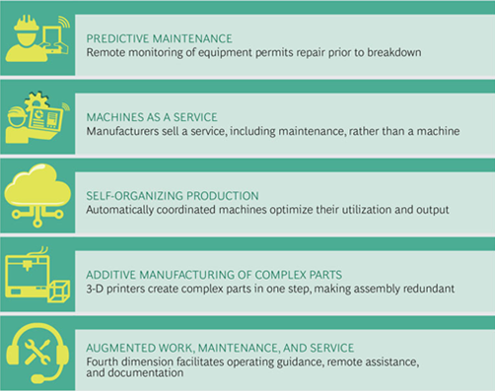
Use cases show the effect of Industrial 4.0 on the workforce
Source: BCG.

Slide 13

Smart Skilled
4.0
High Skilled
นวัตกรรม
3.0
Skilled
OBM
ออกแบบ
2.0
R&D
ODM
Unskilled
แปรรูป
D&D
1.0
Business 4.0
OEM
วัตถุดิบ
Manufacturing
Automation, Robots, Digital
Production

Slide 14
Communication
Collaboration
Critical Thinking
Creativity
Complex problem solving
Professional/ Technical
ICT , IoT
Digital
……….
Hard Skills
Soft Skills
Competency
Applicable
Behavior
Discipline
Accountability
……….
Workforce
4.0
Change adaptation
Characters
Positive
Open mind
………….
Flexibility
Mind Sets
Continuous Learning
Education
Non education
Life Long learning
Learn how to learn
Learn
Unlearn
Relearn
PBL
WIL
AL
…..

Slide 15
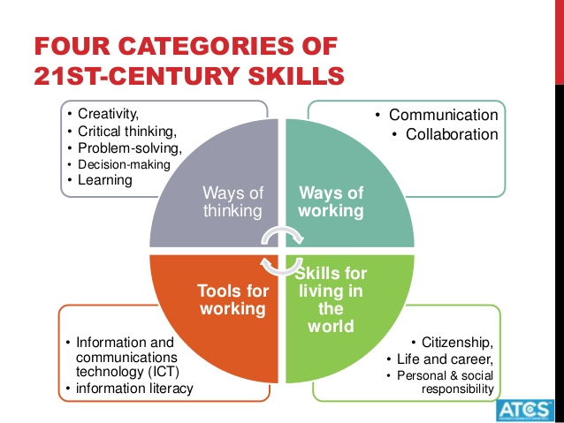

Slide 16
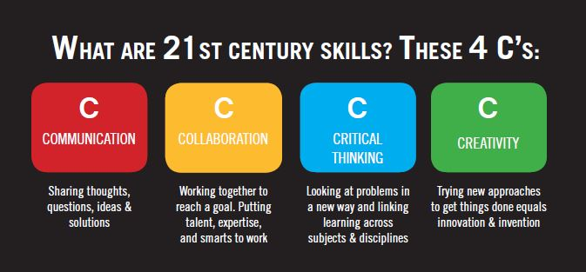

Slide 17

This single skill could save your job
and your company
Learnability: the secret to getting ahead
Images REUTERS/Kim Kyung-Hoon
WEF Article; Mara Swan, Executive Vice President,
Global Strategy and Talent, ManpowerGroup

Slide 18
Project Based Training (PBT)
Target of the action process
Information: Trainees work out the needed information for planning and execution of the task independently
Evaluation: The trainees and the trainer evaluate the process and the result of their work. As a consequence of this, meeting new tasks and targets will be determined and the cycle is closed
Planning: Trainees work out the complete action plan for the task independently
Deciding: Trainees decide about the realisation of the plan with the trainer . The trainer can asses if the students gathered the needed competences.
Quality control: The trainees control and evaluate their own work result. They use the tools which they developed during the planning phase.
Tools and material
Realisation: The students carry out the project task. This can be done individual or in team work, according to the approved plan.

Slide 19
Today and Tomorrow
2Qs : Quantity and Quality
Input
Process
Output
Policy
Budget
Facility
Student
Teacher
Parent
Hard Skills
Soft Skills
Industrial Key Qualifications
Competency
Applicable
Workforce
4.0
Behavior
Technology
Social
Organization
Learning
Change adaptation
Characters
Flexibility
Mind Sets
Continuous Learning
Industrial behavior
Life Long learning
Learn how to learn
Basic engineering skills
Basic Sci., Math., Lang., Computer etc.,

Slide 20
Industrial Key Qualifications
OJT
Company
Role
Technology
Social
Organization
Learning
Further Training
DSD, TGI, … Role
Industrial behavior
Eng., Tech., Voc. Ed.
Basic engineering skills
Basic Sci., Math., Lang., Computer etc.,
General education
Notes:
ทำไมโรงงานต้องจัดการฝึกอบรมเอง

Slide 21
เป็นองค์กรอัจฉริยะ
เพื่อปฏิรูปอุตสาหกรรมการผลิตสู่อุตสาหกรรมอนาคต
2024
2023
2022
2021
2020
Smart HR
Smart Learning Organization
- Staff KPI Evaluation Online
- Time Sheet Online 2020 - OT Approve Online Smart Training (IDP)
Smart Process
Full system TGI 4.0
- TGI One Stop Service - TGI Smart Training Process
Lean Process พัฒนาระบบ E- Leaning Cost Controlling
Machine Monitoring (PI Division) Learning Factory Process
Intelligent Manufacturing with 5G Technology - Robot Calibration Laboratory - Smart Maintenance for Asset Management Technology - Intelligent Automation & Robot - Smart Molding / Stamping with AI
Intelligent Manufacturing - Intelligent Factory Automation - Digital Twin - Smart Maintenance Application Data Center - Smart Stamping Die
- AI Machine Learning and Deep Learning - Automated Vision Inspection Testbed - Smart Moulding
Smart Factory Application Data Center - Robot Application Data Center - Failure Analysis Data Center - Factory Automation Application Data Center - ISO 17025 Certified Vibration Testing Laboratory Data Storage & Information Exchange/Monitoring ISO/IEC17020 (ขยายขอบข่ายการรับรอง)
Smart Factory - Automated Inspection Testbed - Design & Simulation Center - ROS for Industrial Robot - Smart Maintenance - Flexible Manufacturing (Integration of sensor / actuator, M2M) - ISO/IEC17020 (รับรองเครื่องจักร BOI)
Smart Service
E- Receipt Big Data & Machine Learning System Implement AI System for management Smart Building Anytime Anywhere working
- Implement All System & Online Application - Integrate System & Database Energy Saving
- Marketing Automation พัฒนา และปรับปรุงระบบ เพื่อรองรับการใช้งานบน Cloud Computing Smart Credit Online E-Finance Automatic Entrance Smart Inventory Smart Fixed Asset
- TGI Business Monitoring พัฒนาระบบฐานข้อมูล Intelligent Data Base Car Booking & Maintenance Approve Online - Online Booking & E-Payment
Smart CRM ขยายสัญญาณ Access Point ทั่วสถาบันฯ พัฒนาระบบ Single Sign On Smart Registration Module MICE Certificate
Smart Support
2024
2023
2022
2021
2020
Technology Trends & Customer Needs
TGI 5 Years Development Roadmap 2020-2024

Slide 22


Challenge Questions
For Sustainability
Organization Structure
Organization Design and Development
Quality of Services
Services Technological Facilities Development
5. Human Resource Development (fit to the needs of industry)
22/31

Slide 23
Q & A

Slide 24


